Slide 1
PYTHON
ABDUL RAFAY

Slide 2
What is Python?
Python is a programming language.
It's used to create games, websites, and more!

Slide 3
Your First Python Program
print("Hello, world!")
What Does It Do?

Slide 4
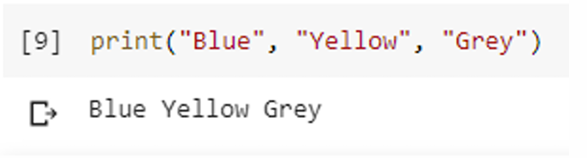
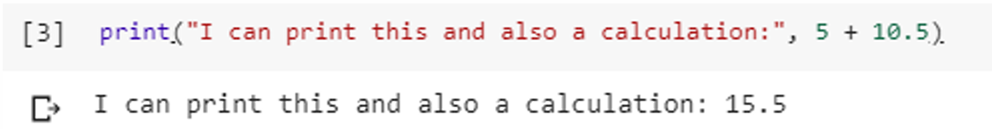
Printing Examples

Slide 5
Variables
What Is a Variable?

Slide 6
Variables
What Is a Variable?
Example: age = 9, Name=“Wanda”, Power=“Magic”
Variables can store different types of data like numbers and text.
! Think Of a variable like a box
that can hold different things for us.

Slide 7
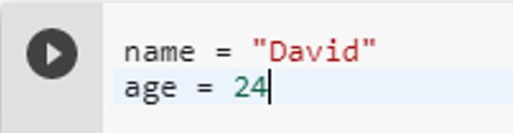
Variables
What Is a Variable?
Example: age = 9, Name=“Safa”, Power=“Magic”
Variables can store different types of data like numbers and text.

Slide 8
Basic Data Types
Integers: 7, 3,14
Strings: "Hello", "Python"
Booleans: True, False
Floating Point Numbers: 3.2,77.7

Slide 9
Simple Math
Addition: 2 + 3 results in 5
Subtraction: 5 - 1 results in 4
Multiplication: 4 * 2 results in 8
Division: 10 / 2 results in 5.0

Slide 10
Simple Math
Basic operations: +, -, *, /
For Example: 2 + 3, 5 – 1

Slide 11
Input from the User
Example: name = input("What is your name? ")

Slide 12
Strings and Concatenation
Strings are text inside quotes.
We can combine strings using ‘+’

Slide 13
Strings and Concatenation
WHAT DOES THE FOLLOWING CODE DO??
greeting = "Hello" + " " + "world"
print(greeting) # Output: Hello world

Slide 14
Adventure time
Consider This “The Adventure Game”:
Characters:
1. You (the adventurer)
2. Magical Forest (where different paths have different outcomes)
3. Dragon (who gives riddles)

Slide 15
Adventure time
Scenario:
You are an adventurer in a magical forest where you came across two paths.

Slide 16
Adventure time
Conditions:
1. If you take the left path, you find a treasure chest.
2. Else (if you take the right path), you meet a friendly dragon who gives you a riddle.
Here when dragon asks you a question it is like taking an input

Slide 17
Conditional statements
Like in the previous adventure game you had two choices either you can choose right path or left path.
Similarly, the conditional statements have two statements one is “if statement” other is “else statement”

Slide 18
if & else statements
If Statement: Think of it like a rule. If you follow the rule (say "Please"),
you get a treat.
Else Statement: If you don't follow the rule, something else happens
(no treat, and the box says "Try again").

Slide 19
else if/elif statement
Now, another of statement is “else if” or “elif”
To understand this lets say you have to decide what to eat in breakfast
If Statement: Choosing pancakes results in a big stack of pancakes.(Choice 1)
Elif Statement: Choosing waffles results in a plate of waffles. (Choice 2)
Else Statement: Choosing anything else results in a bowl of cereal. (Choice 3)

Slide 20
Real-Life Examples:
If it's raining, then take an umbrella; else, enjoy the sunshine!
If you finish your homework, then you can play a game; else, you have to keep studying.
If it's a weekday, then go to school; elif it's a Saturday, then go to soccer practice; else, enjoy your Sunday!
If you see a red light, then stop; elif you see a yellow light, then slow down; else, if you see a green light, you can go.

Slide 21
Random number
Think of a dice!!
A dice has 6 faces
When we roll the dice a random face with numbers from (1-6) comes up

Slide 22
Steps to Make a Random Number in Python
Step 1
Import Random Module

Slide 23
Steps to Make a Random Number in Python
Step 1
Import Random Module
Step 2
Use The randInt() function to generate random number

Slide 24
Steps to Make a Random Number in Python
Step 1
Import Random Module
Step 2
Use The randInt() function to generate random number
Step 3
Print the Number

Slide 25
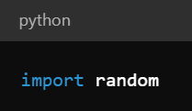
Step 1
What it does: This line tells Python that we want to use a special tool called the "random module" which has the ability to create random numbers.
Analogy: Imagine opening a box of magic tricks that will help you perform your magic show. In this case, the magic trick is making random numbers.

Slide 26
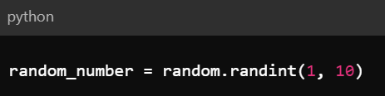
Step 2
What it does: This line uses the randint function from the random module to generate a random number between 1 and 10, inclusive, and stores it in a variable called random_number.
Analogy: Imagine you have a magic hat that you can reach into, and when you pull your hand out, you have a piece of paper with a random number between 1 and 10 written on it. You then write that number down on a piece of paper named random_number.

Slide 27
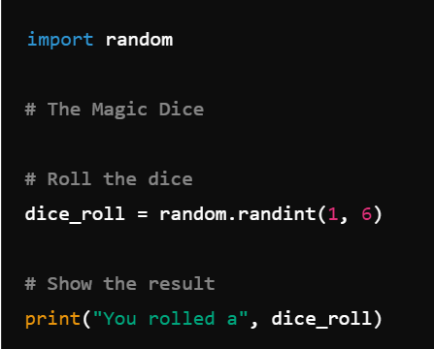
Random numbers on the dice
Tells the computer that we want to use a special Library
This line "rolls" the dice by picking a random number between 1 and 6 and stores it in a variable called dice_roll.
This line displays the message "You rolled a" followed by the number stored in dice_roll.

Slide 28
Concept of loop
REMEMBER!! In Doctor Strange (MOM)
When Doctor Strange traped Dormammu in a time loop where the same events were repeating over and over again until Dormammu gave up.
This is similar to how a loop in programming repeats the same code multiple times.
What it does: A loop repeats a set of actions multiple times.
Analogy:

